Slide 1
Apple Products

Slide 2
Apple Products
Mac Pro
IMAC
IPAD
IPHONE

Slide 3
Apple
Top Features of Mac:
Sleek design with a lovely body and impressive features.
Mac fits well with all other Apple products like iPhone, iPad or iPod touch etc.
It does not have any (notable) virus written for it; nor does it face malware attacks.
Mac allows running windows in a legal way via Boot Camp.

Slide 4
Apple
Top Features of Mac:
Quality and professional customer support system of Apple is an added advantage.
Unlike Windows, when you buy a Mac, it does not come pre-loaded with crapware and trial ware unlike a new pre-installed Windows computer. This is the tragedy of a Windows computer as such craplets, end up slowing down Windows.

Slide 5
PC
Top Features of a PC:
Provides scope for total customization. Anyone can start working with a PC from the scratch to build it his own way.
PCs generally have quality software compatibility.
Most suitable for upgrades. You will still be able to run your Windows Next on your current Windows computer.

Slide 6
PC
Top Features of a PC:
People are more accustomed with it because of long co-existence.
Possesses a wider support system. Has a great ecosystem and freeware options.
Has comfortable backward adjustment capacity. For e.g. a Windows 7 can run on an old PC.
Around 90% people worldwide prefer to use Windows.
Has a greater satisfaction ratio.

Slide 7
PROS and CONS
There aren't a lot of things that separate the Macs from the PCs, but then again, they couldn't be more different either. They might essentially have the same hardware, but their 'packaging' and their approach are poles apart. While the PC seems to be more user-friendly, and enjoys popularity, the Mac caters to a niche audience.

Slide 8
PROS and CONS Hardware
PC
An aspect that heavily tilts the balance in favor of PCs is the fact that you have the option to choose and customize your machine right from scratch. You can choose to either go in for a branded computer, which still offers you a fair bit of customization, or you could opt to pick up the best products of all computer manufacturers and assemble them to have your own little supercomputer to cater to all your needs, and to a certain extent, your greed! You can also easily upgrade your old computer to quite an extent with the latest hardware available.
Mac
The iMac boasts of some real impressive hardware, which in turn churn out some serious processing power. The only drawback with it is that you do not get to do a great deal of customization with the hardware, as you pick up your iMac. There is no way to assemble a Mac by yourself, as it is solely produced by Apple and comes only in a select few variants. Also, there is very little upgradation that you can do with your iMac, although it already has a very impressive spec sheet. Syncing your iPod, iPad or iPhone is a breeze when you have an iMac.

Slide 9
PROS and CONS Hardware
Mac
The iMac boasts of some real impressive hardware, which in turn churn out some serious processing power. The only drawback with it is that you do not get to do a great deal of customization with the hardware, as you pick up your iMac. There is no way to assemble a Mac by yourself, as it is solely produced by Apple and comes only in a select few variants. Also, there is very little upgradation that you can do with your iMac, although it already has a very impressive spec sheet. Syncing your iPod, iPad or iPhone is a breeze when you have an iMac.

Slide 10
PROS and CONS Operating System
PC
Computers, world-over, mainly run on the Microsoft Windows operating system. Easy access and being comparatively easy to set up, most PCs come with some variant of Windows pre-loaded on them. As it caters to more than 90% of computer users, almost all software are designed for Windows PCs. Another feature of the personal computer is the fact that you can choose to have two operating systems on it (two versions of Windows), or if you really want, you can even configure it to have Microsoft Windows and Apple OS on board, although it would be a bit more complicated to set up.
Mac
The iMac runs the much acclaimed Apple proprietary, Mac OS. In addition to this, users can also opt in for a dual-boot configuration, wherein one can boot either into Mac OS or Windows as and when one wishes to do so.

Slide 11
PROS and CONS Operating System
MAC
The iMac runs the much acclaimed Apple proprietary, Mac OS. In addition to this, users can also opt in for a dual-boot configuration, wherein one can boot either into Mac OS or Windows as and when one wishes to do so.

Slide 12
PROS and CONS Compatibility
PC
When you compare the computer operating systems, or study a Mac vs. Windows pros-cons list, you will find that PCs are always backward compatible. This is a major advantage that they have over Macs. New operating systems like Windows 7 can be run on a relatively old PC without much of a hassle. Almost all the software available in the market are Windows compatible, and run smoothly on PCs with the required config.

Slide 13
PROS and CONS Compatibility
Mac
A major chink in the iMac's armor is the fact that they are not backward compatible. Simply put, it means that most newer Apple Mac OSes will not run on older versions of their iMacs. So, OS X Lion will not run on a Mac Mini, for instance. Also, not all software in the market are designed to run on Mac OS, although most newer software and applications are compatible with both Windows and Mac. In either scenario, as the newer generation of Macintoshes support both Mac OS and Windows, this shouldn't really be much of a problem.

Slide 14
PROS and CONS Looks and User Interface
PC
Personal computers these days, are no longer the ugly and cumbersome eyesores they used to be. In fact, the ugly duckling seems to have transformed itself into a beautiful and powerful swan! Apart from just the processing power, people these days opt for beautiful showpieces to add to the aesthetics of the house. To match up to this, MS Windows, the main OS for these elegant machines, is something that is rather simple to use, more so, because over the years, most of us have gotten used to the interface. The newer versions of Windows, ironically, take a leaf out of their supposed complicated-to-use-rival, the Mac OS, and are even more fine-tuned to try to enhance the entire user experience, with a more polished look.

Slide 15
PROS and CONS Looks and User Interface
Mac
Till the introduction of the Macintosh, which was a totally new breed of computing machines, all computers in the market were always seen as big ugly pieces of equipment. With the Mac, Apple changed the world's outlook towards computers. With their compact and beautiful form factor, iMacs these days are absolutely gorgeous, and now even offer up to 27" of real estate in terms of screen size. This is topped up with a very refined, and contrary to popular belief, a very easy-to-use OS. The Mac OSes have always been quite a spectacle, with their real smooth buttery user interface. Mac OSes have often been mistaken to be extremely complicated to use, wherein in fact, it is actually one of the best interfaces to work with.

Slide 16
PROS and CONS Security
PC
Security is by far the biggest issue that bothers PC users all over the world. With the Internet boom, which has made Internet connectivity easily available and very affordable, computers everywhere face a constant threat of being attacked by viruses and hackers. Cyber crime is also on the rise, with identity theft and phishing being very rampant. Personal computers are very vulnerable to these attacks, as they are the most widely used computing machines, and their many loopholes have been exposed and exploited by hackers and the many viruses on the prowl.

Slide 17
PROS and CONS Security
Mac
Security is one area that Apple has always flaunted as one of the biggest strengths of the iMac. The Mac is at a much lesser risk of being under attack from malicious software and hackers because of its security features.

Slide 18
PROS and CONS User Base
PC
The fact that personal computers have been in the market even before the whole idea of the Macs was conceived, gave them a huge and almost unassailable lead. PCs rule the market, with about 70% of the market share to their name. They cater to a huge segment of the society, right from the basic personal computers at home, up to advanced computers used in corporates for programming and data processing. Hardcore gamers too prefer PCs because they can be easily customized, and you wouldn't need to pay an arm and a leg to buy one, unlike an iMac with a similar configuration.

Slide 19
PROS and CONS User Base
Mac
Although the market share for the iMac has grown by notches, it still only accounts for a paltry 10% of the consumer market. Apple has always targeted a niche group of consumers, and hasn't wavered from its approach a lot. The concept that Apple follows is to service the premium share of the market, and not compromise on quality, even if this results in a lower market share. iMacs are preferred over the conventional computers in the field of animation, visual effects and sound editing. This is mainly because certain advanced editing and designing software used in these fields are compatible on machines running the Mac OS. Also some offices use the iMac more for its aesthetic appeal. For the affluent class, their iMacs are their status symbols, although the scenario has changed quite a bit lately.

Slide 20
PROS and CONS Price
PC
With production costs coming down drastically, and a lot more players entering the PC manufacturing industry, you can get yourself a computer with a decent configuration for less than a basic television set. What also helps to make them so popular is the fact that the software for PCs is easily available and at really low rates. Computers no longer seem to be a luxury but instead have become an essential part of daily life for people.

Slide 21
PROS and CONS Price
Mac
Most people will shout out "Highway robbery", the moment they hear the mention of Apple, and sadly, the iMac does little to change this notion. The iMac undoubtedly makes you feel a part of an elite group, but it comes at a premium. All-In-One computers these days offer the same, and at times, a better experience, both in terms of looks and performance at a much lower price. But the fact remains that once you've had a 'bite' of an Apple, you just can't seem to have enough of it, of course, that is if you can afford it.

Slide 22
PROS and CONS Summary
Over the years, personal computers and Macs have learned to co-exist, with one being hugely popular with the masses and the other still choosing to cater to a niche group of users. At the end of the day, it all boils down to the user's requirement. While Apple bashers and PC haters will always look to belittle the other, trying to compare the two would really be like choosing between 'apples' and oranges! I rest my case.

Slide 23
What is the ICLOUD???
ICOUD Explained

Slide 24
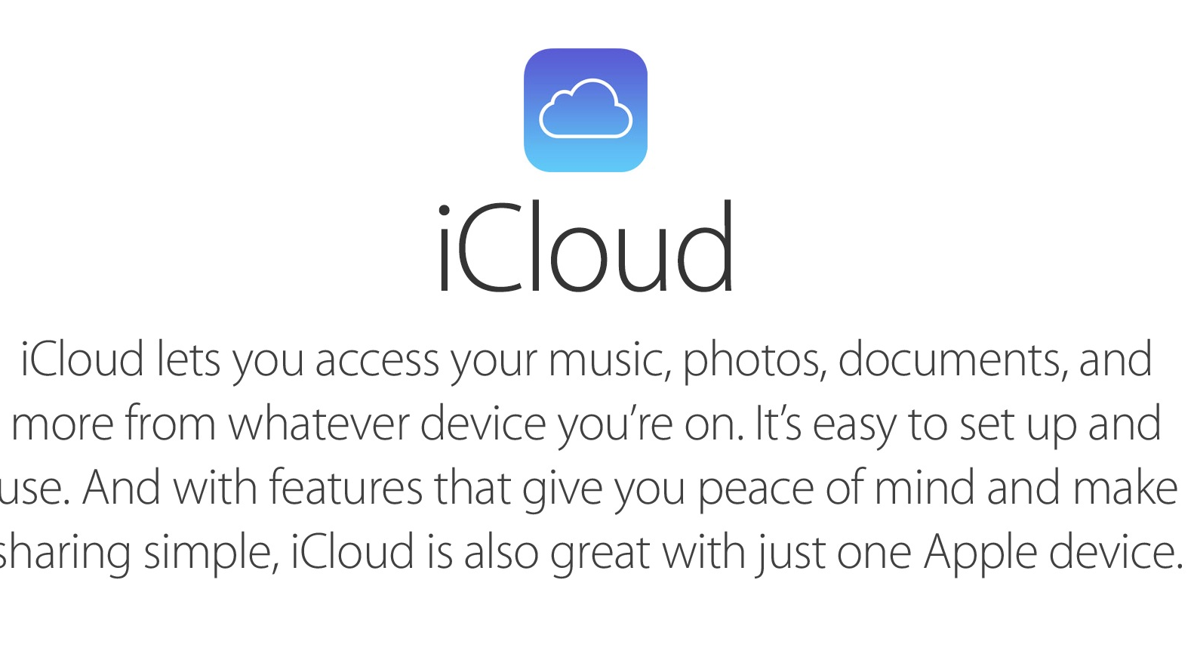

Slide 25
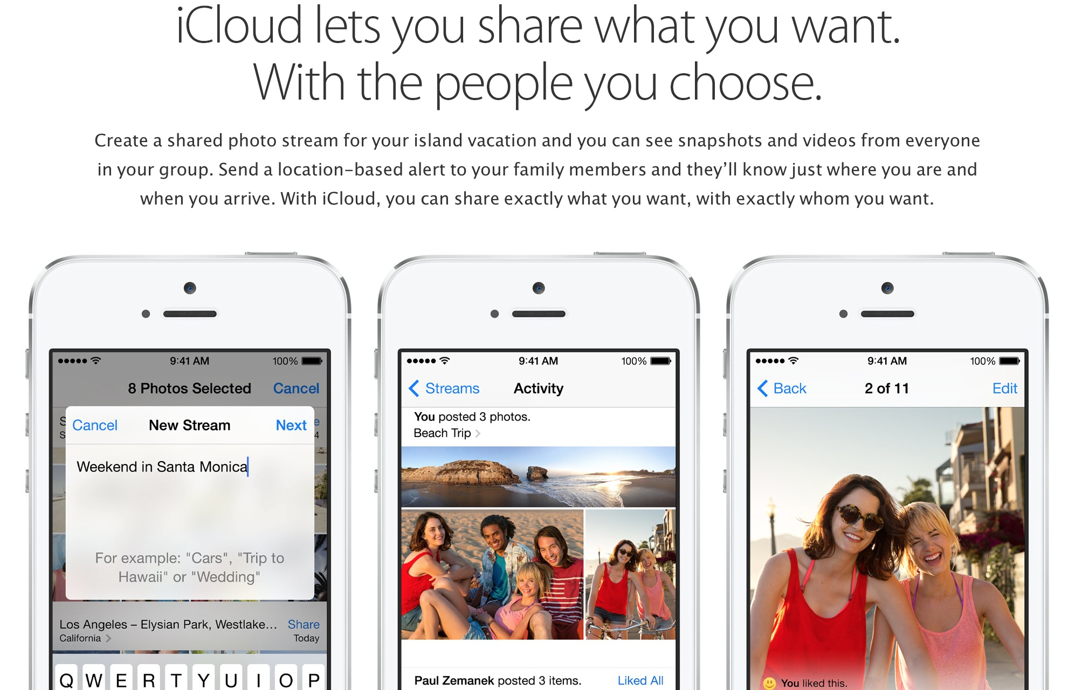

Slide 26
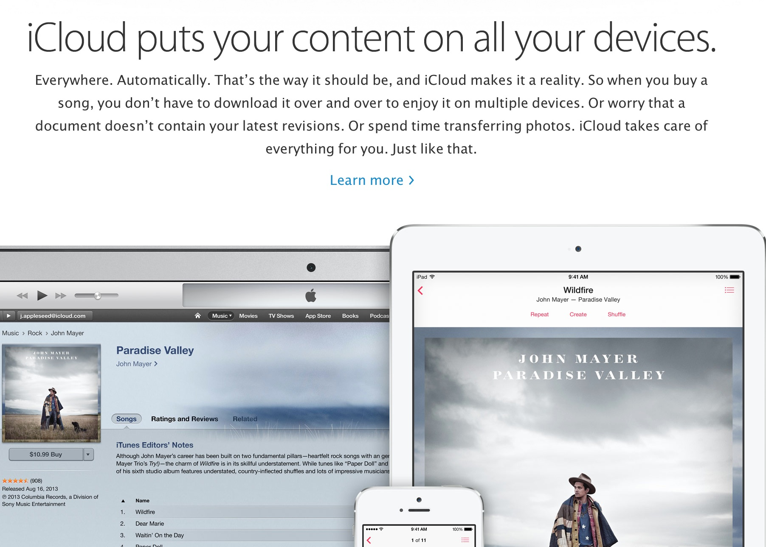

Slide 27
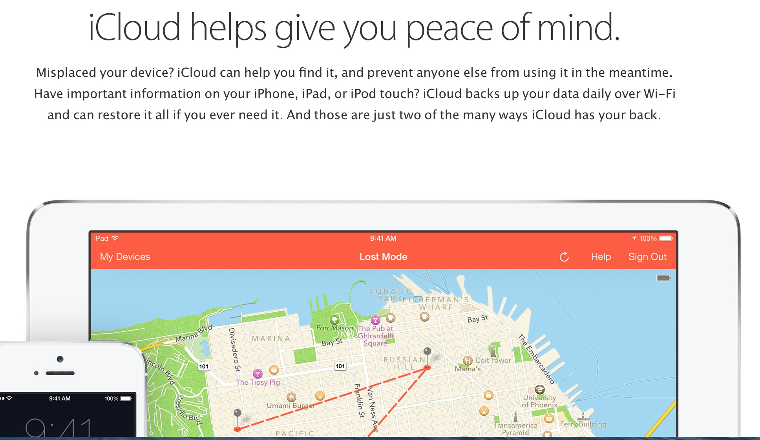

Slide 28
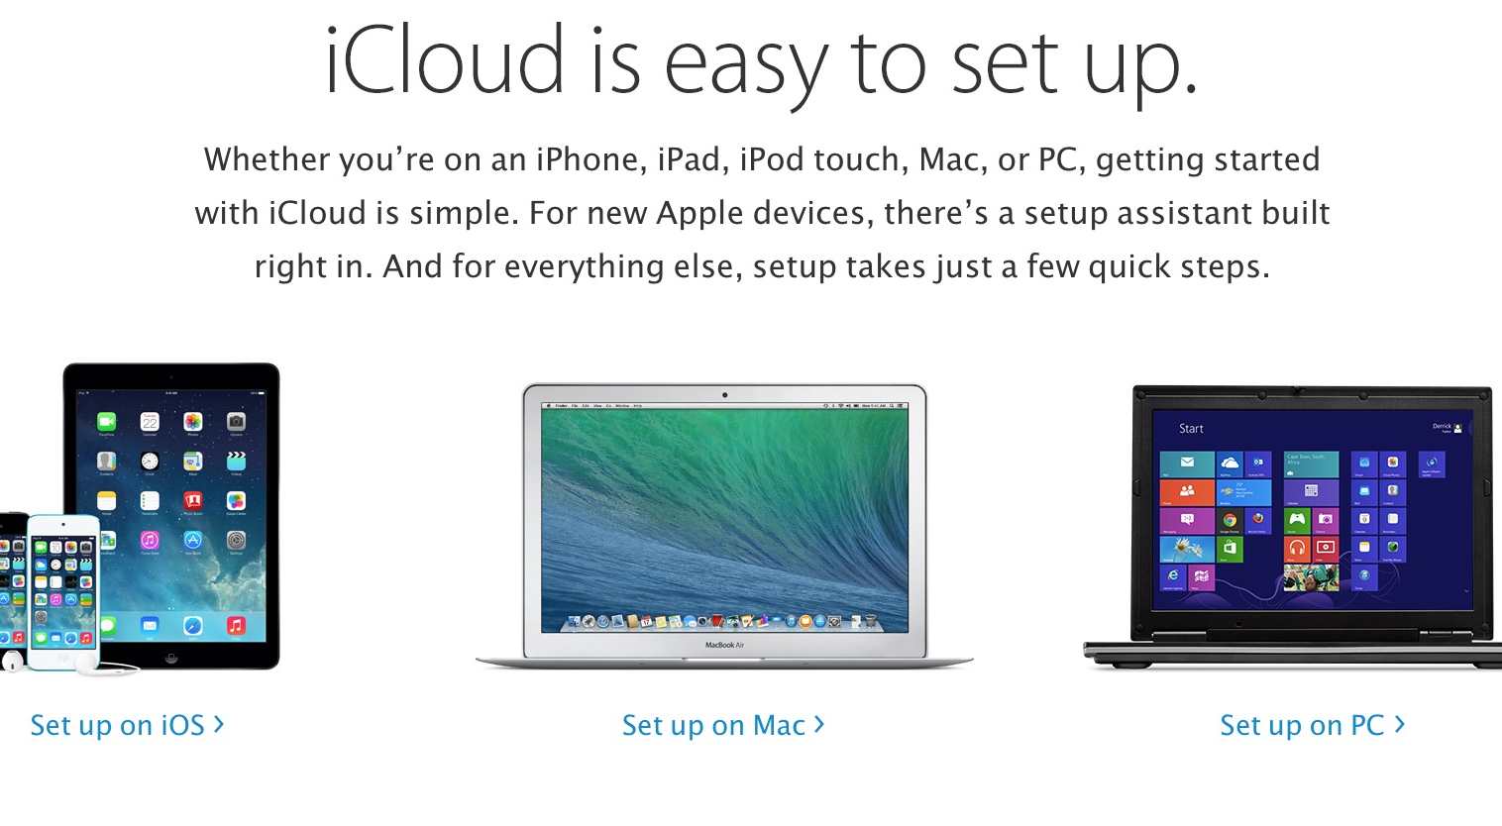

Slide 29
Evaluations
What do you want or like to do?
  Emails
  Office Suite (word processing, spread sheets, presentations)
  Videos
  Photos
  Music
  Movies
  Etc.

Slide 30
Evaluations
Cost/benefits to consider?
  Budget
  Training
  Technical Support required

Slide 31
Evaluations
Converting Data?
  Photos
  Files Letters, spread sheets, etc.
  Music

Slide 32
Evaluations
Files to be imported?
  Emails
  Special software file requirements
  Shared data files

Slide 33
Evaluations
How different are the machines?
  Technically – quite a lot, but transparent to users
  Special software file requirements – will it work on both
  Shared data files – not much difference
  In the end, they are both computers

Slide 34
Evaluations
Backing?
  How critical is this for you?
  Can you survive a crash
  Both PC and MAC platforms have full solutions

